Slide 1
Gym Member Exercise Data Analysis
School Project
by Stephen Coates
December 2024
Notes:
My name is
I am a student
I chose this dataset as it was related to exercise, the rationale being that
I currently have 2 personal training clients and have completed an assoc here at the college in Exercise Science

Slide 2
Introduction
Can this collection of exercise data be used to help the gym increase membership
Does this data also help the gym create better programs
This data is universal and while tedious to collect the lessons learned could apply to most gyms
Personal trainers might also be able to leverage the results and conclusions for their individual members even if they cannot collect as much data, maybe they can share with other solo trainers
Notes:
This data collection was made to see if the gym could identify any helpful strategies to increase membership
A side benefit could also be development of better programs at the gym
As the data is fairly universal it could be used by other gyms

Slide 3
Methodology
The data was sourced from Kaggle
Kaggle Dataset
The data provides an overview of gym members exercise routines, physical and fitness metrics.
The dataset was a csv file, imported into a Jupyter notebook where it was explored, cleaned and reported on using pandas, python, leveraging the matplotlib and seaborn packages for reporting
Notes:
The data was obtained from Kaggle
The gym member exercise dataset contains demographic information along with summary information on the workout type, average and max bpm during exercise
It is a csv file and I used Jupyter notebooks with python, pandas, matplotlib and seaborn to perform my EDA

Slide 4
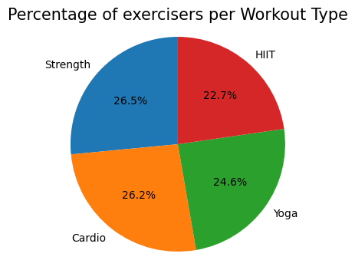
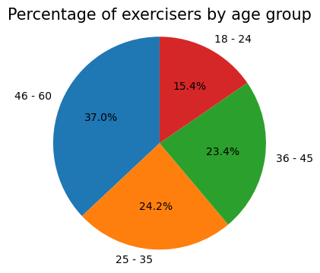
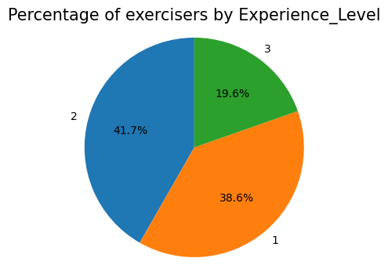
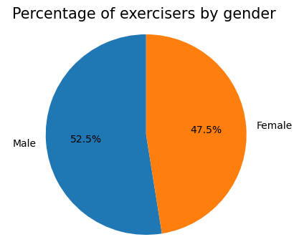
Demographic Information on the Gym’s Members
Notes:
Straightforward summary demographic numbers – no remarkable breakdowns found

Slide 5
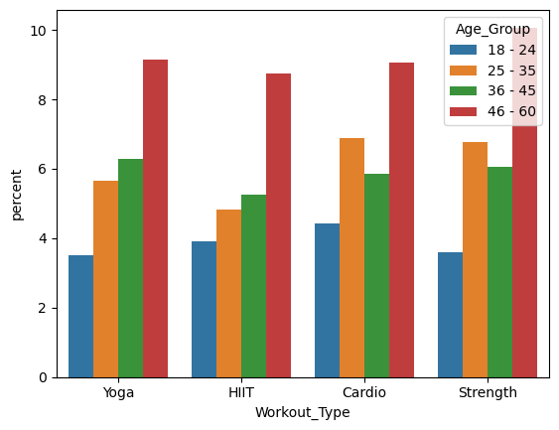
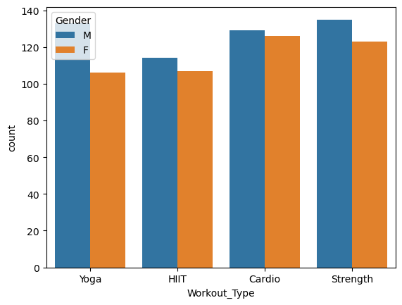
Breakdown of Workout Types for the Gym’s Clients
By Age Group and Gender
Notes:
The older group is larger, (note it does span 14 years more than the other age groups
Do the members really only do one type of workout

Slide 6
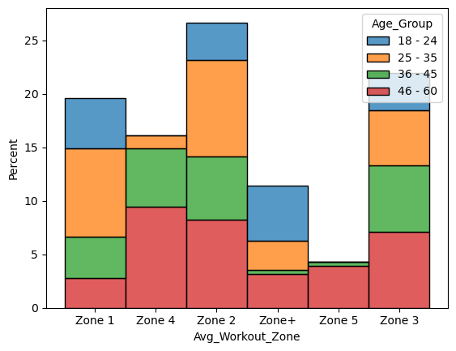
The current industry standard is that cardio should be performed mostly in heart rate zone 2
The average bpm recorded in the dataset shows 27% of the clients doing cardio had an average bpm in their zone 2
Notes:
I wonder what the session time average was for the zone 5 averages clients

Slide 7
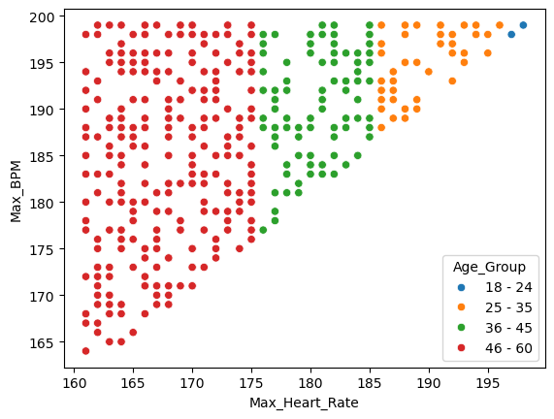
OUTLIERS to validate
Below is a list of people who have max bpm above their calculated zone 5 maximum heart rate
I notice that my heart rate climbs easily to my max with some exertion but___
There are some clients here that are getting near 200, which seems unlikely

Slide 8
OUTLIERS to validate ……
Below is a list of people with a good fat percentage with very high BMI number, note obese starts at over 30
Age Gender Fat % BMI BMI Desc Weight (lbs) Height (in)
10 41 M 20.5 43.31 Obese 265.8 65.7
55 23 M 21.7 44.84 Obese 252.6 63.0
261 57 M 20.8 47.72 Obese 279.0 64.2
291 55 M 20.4 45.49 Obese 282.5 66.1
302 36 M 20.4 43.31 Obese 272.1 66.5
408 46 M 20.5 40.45 Obese 239.4 64.6
593 55 M 21.7 43.40 Obese 285.8 68.1
687 18 M 20.6 45.14 Obese 277.0 65.7
710 38 M 21.2 46.98 Obese 271.3 63.8
854 48 M 21.4 49.84 Obese 284.2 63.4

Slide 9
OUTLIERS to validate ……
Below is a list of people with a great BMI with a high Fat Percentage,
Age Gender Fat % BMI BMI Desc Weight (lbs) Height (in)
4 38 M 29.2 14.39 Underweight 101.4 70.5
17 41 F 31.9 13.98 Underweight 96.4 69.7
130 49 F 30.8 14.93 Underweight 99.4 68.5
156 56 F 30.0 12.47 Underweight 88.9 70.9
194 49 F 34.3 14.69 Underweight 88.0 65.0
282 24 F 31.8 13.71 Underweight 92.4 68.9
343 46 M 29.1 14.36 Underweight 99.0 69.7
401 42 F 32.9 14.10 Underweight 93.9 68.5
504 42 F 28.1 14.87 Underweight 102.5 69.7
537 31 F 34.9 13.78 Underweight 93.9 69.3
581 45 M 29.0 14.85 Underweight 115.5 74.0
586 56 M 29.8 13.81 Underweight 106.3 73.6
783 47 M 29.6 12.32 Underweight 101.0 76.0
873 25 F 31.9 14.74 Underweight 90.4 65.7
874 43 F 32.9 13.38 Underweight 89.1 68.5
909 28 M 28.2 14.57 Underweight 128.3 78.7
Notes:
If nothing else it might dictate what sort of exercise they should be doing

Slide 10
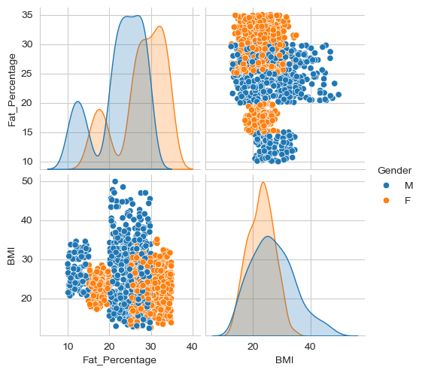
This plot illustrates the relationship between fat percentage and BMI.
There is some clear bunching by gender
Are there no men with a fat % between 16% and 19%?
Likewise, are there no women with fat % between 21%and 24%?
The higher BMI numbers for males is explained by being more likely to be heavily muscled, but there aren’t any men with a fat % over 30?
Note
a BMI below 18.5 is considered underweight
a BMI of 30 is considered obese
Notes:
Some strange anomalies

Slide 11
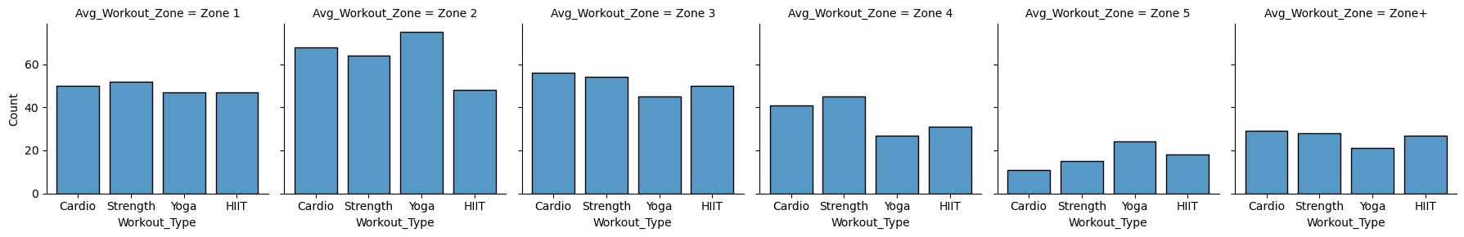
The heart rate zone calculations are somewhat suspicious to me
The trainers at the gym should be targeting appropriate heart rate zones by workout type and experience level
Very few people will have an average BPM in zone 3, 4 and 5 for an hour. Most will see those heart rate zones in a workout such as a HIIT.
For a cardio workout most of the time should spent in zone 2 or 3, with some occasional bursts into 4 and 5 but not an average zone of 4 or 5
While yoga can be a strenuous workout it does not normally come with high average bpm in zones 3,4 and 5
Surely members do more than one workout type?

Slide 12
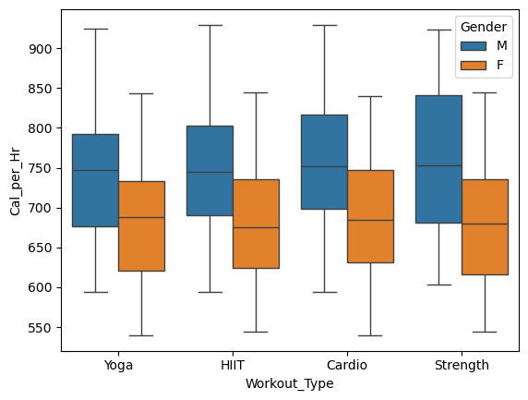
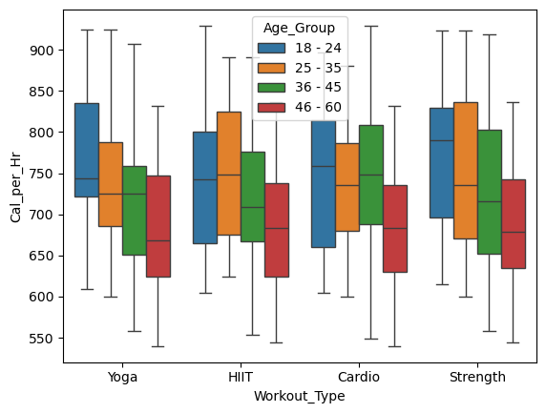
Calories burned increasing along with increasing heart rate makes sense

Slide 13
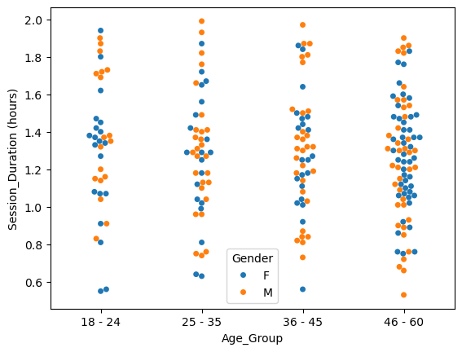
Session duration in Hours by Age Group
This a visual showing data only the HIIT workout type
Does anyone do HIIT for more than 1 hour ?
The session duration looked too long to me,
Most sessions in my experience are 45 to 60 minute long, with many HIIT classes being only 30 minutes.
Notes:
As the plot had too many points for all the data I selected just the members who did the HIIT workout type.
Do the members stick with one workout type
I wonder if the hours should be divided by the number of sessions?

Slide 14
Results
From the perspective of guiding improvements in membership there were not clear messages in the data. The lack of a progress towards a goal metric is a significant drawback. That is often the main selling point, lower weight, more squats, higher bench press - to attract new members.
The gym needs to decide on what services they want to provide, which do they expertise or which are the most profitable. Classes such as yoga and HIIT are often good ways to boost referrals, they can differentiate a gym from another that just has equipment.
There was extensive data however much of it appeared questionable
The Gym important, to review its procedures and equipment as it is collecting heart rate numbers.
Fat percentage is less important, but many members are focused on body composition, and it is a good metric to measure progress
The gym could provide some education for their members around how to monitor heart rate activity and their exercise routines

Slide 15
Future Work
Tracking periodic data from members would be good so that progress can be tracked – success stories can sell
More granular data preferably by each session
Main takeaway is the accuracy of the measurements
Who was counting the beats per minute?
Could some wear a heart rate monitor as a control
Take advantage of some personal tech like watches to confirm data
Quality of instrument providing fat percentage
Assumption is that weight and height are easy to reliably collect
Gather information from surveys, in particular exit surveys
This could help design new programs or enhancing existing ones
What are the key drivers of gym selection by a member
Notes:
Collect better data in general is the overarching message.
For the data to provide useful feedback it needs to track over time so progress can be seen and shown
For the heart rate activity data to be useful it needs to be accurate

